Slide 1
Applications of Information and Communication Technologies
Rabail Asghar
Lecturer (Computer Science)
COMSATS University Islamabad, Lahore Campus

Slide 2
Topics to cover
Python Operators

Slide 3
Python Operators
Operator=The operator can be defined as a symbol which is responsible for a particular operation between two operands.
Operant=The value(s) on which the operator acts.

Slide 4
Python Operators
Arithmetic operators
Comparison operators
Assignment Operators
Logical Operators

Slide 5
Arithmetic Operators
Arithmetic operators are used to perform arithmetic operations between two operands.
It includes + (addition), - (subtraction), *(multiplication), /(divide), %(remainder), //(floor division), and exponent (**) operators.

Slide 6
Arithmetic Operators
Example of Arithmetic operators:-
a=20
b=10
c=a+b
print(c)
c=a**b
print(c)

Slide 7
Arithmetic Operators
Arithmetic operators are used to perform arithmetic operations between two operands.
It includes + (addition), - (subtraction), *(multiplication), /(divide), %(reminder), //(floor division), and exponent (**) operators.

Slide 8
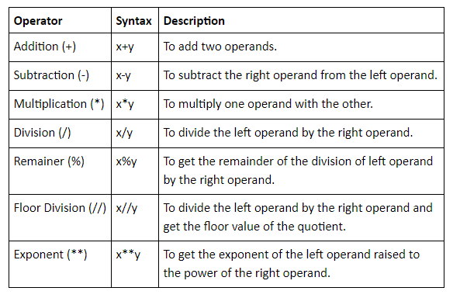
Notes:
it rounds down to the nearest integer

Slide 9
Assignment Operators
The assignment operators are used to assign the value of the right expression to the left operand.

Slide 10
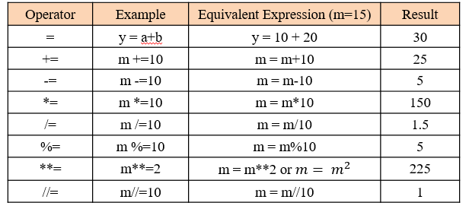
Assignment Operators
Notes:
+= “”add and assign””

Slide 11
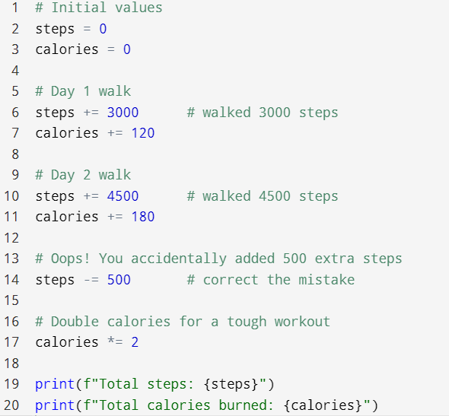
Practice
Scenario: Daily Step Counter
Notes:
Total steps: 7000
Total calories burned: 600

Slide 12
Comparison Operators
Comparison operators are used to comparing the value of the two operands and returns Boolean true or false accordingly.

Slide 13
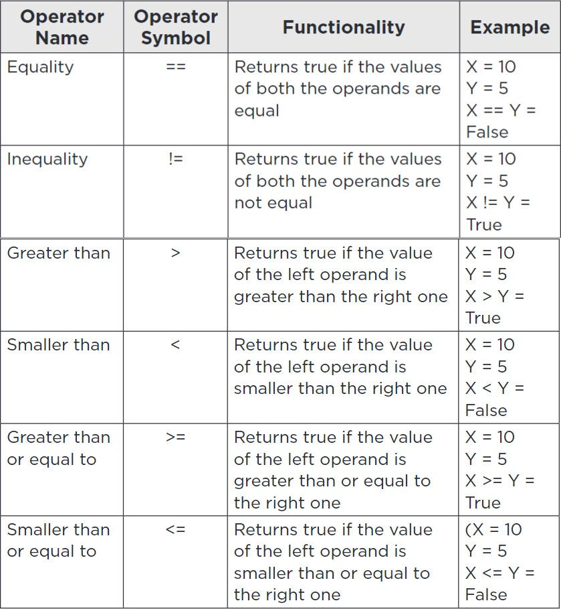
Comparison Operators

Slide 14
Practice
Create a scenario and show the working of comparison operators and Display the results..

Slide 15
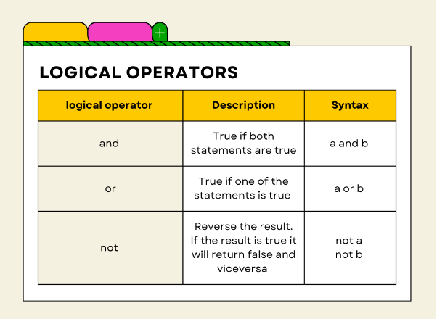
Logical Operators
In programming, logical operators evaluate expressions to produce a Boolean outcome of true or false.

Slide 16
Logical Operators
Short circuit evaluation:
Python stops evaluating the conditions as soon as the outcome is determined.
This is particularly relevant for the or and and logical operators:
Logical OR (or):
Python will evaluate the first condition first. If the first condition is True, Python does not check the second condition because the overall result will be True regardless of the second condition.
Logical AND (and):
Python will evaluate the first condition first. If the first condition is False, Python does not check the second condition because the overall result will be False regardless of the second condition.

Slide 17
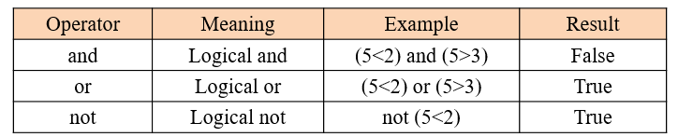
Logical Operators

Slide 18
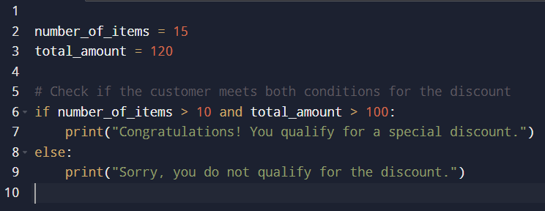
Logical Operators in conditional statements

